Slide 1
Classification Loss
b
b
Ge
Gd
C
Xa
C
b
z
Xb
C
Gd
D
R/F
a
Xaˆ
Xa
Reconstruction Loss
a: Disentangled latent from Xa
b: Random sampled vector
Xa: real image

Slide 2
Classification Loss
b
b
Ge
Gd
C
Xa(edge)
C
b
z
Xb
Xa
C
Gd
D
R/F
a
Xaˆ
Xa
Reconstruction Loss
a: Disentangled latent from Xa
b: Random sampled vector
Xa: real image

Slide 3
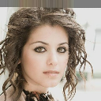
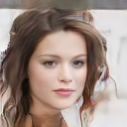
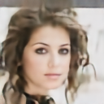
Classification Loss
b
b
Ge
Gd
C
Xa
C
b
z
Xb
C
Gd
D
R/F
a
Xaˆ
Xa
Reconstruction Loss
a: Disentangled latent from Xa
b: Random sampled vector
Xa: real image

Slide 4
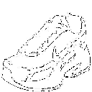
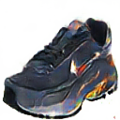

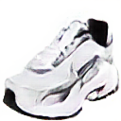
Classification Loss
b
b
Ge
Gd
C
Xa(edge)
C
b
z
Xb
Xa
C
Gd
D
R/F
a
Xaˆ
Xa
Reconstruction Loss
a: Disentangled latent from Xa
b: Random sampled vector
Xa: real image

